Slide 1
Meta-path based Multi-Network Collective Link Prediction
Speaker: Jim-An Tsai
Advisor: Jia-ling Koh
Author: Jiawei Zhang, Philip S. Yu, Zhi-Hua Zhou
Date: 2015/6/18
Source: KDD’14

Slide 2
Outline
Introduction
Framework
Experiment
Conclusion

Slide 3
Motivation
+

Slide 4
Purpose

Slide 5
Outline
Introduction
Framework
Experiment
Conclusion

Slide 6
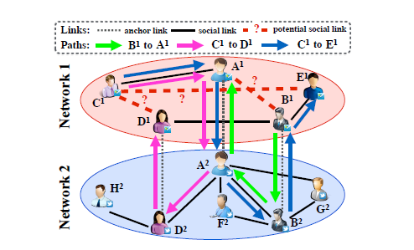
Multi-network link prediction problem
1. lack of features
2. partial alignment
3. network difference problem
4. simultaneous link prediction in multiple networks

Slide 7
Multi-network Link Identifier

Slide 8
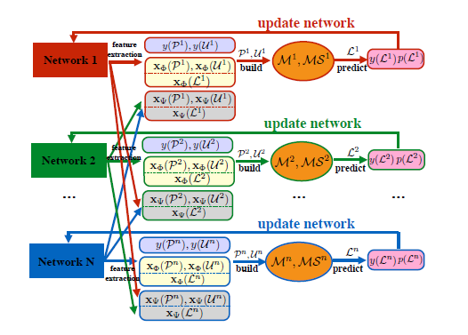
Part of MLI
1. Social meta path based feature extraction and selection
2. PU link prediction
3. Multi-network link prediction framework

Slide 9
Social meta path based feature extraction and selection
1. Intra-Network Social Meta Path
2. Social Meta Path based Features
3. Anchor Meta Path
4. Inter-Network Social Meta Paths
5. Social Meta Path Selection

Slide 10
Intra-Network Social Meta Path

Slide 11
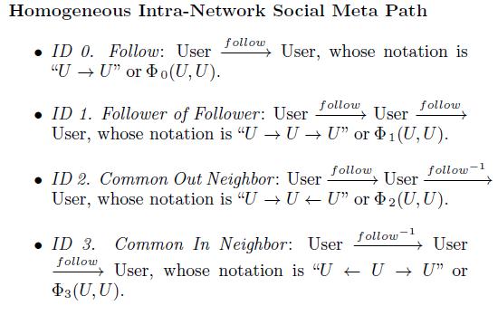
Intra-Network Social Meta Path

Slide 12
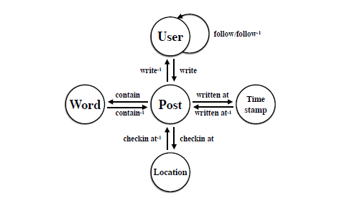
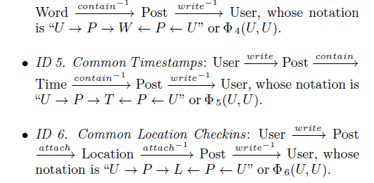
Intra-Network Social Meta Path

Slide 13
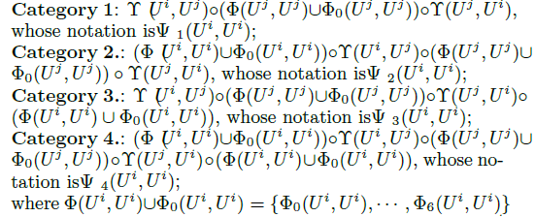
Inter-Network Social Meta Paths

Slide 14
Social Meta Path Selection
X : a feature extracted based
on a meta path in
Y: the label

Slide 15
PU link prediction

Slide 16
Multi-network link prediction framework

Slide 17
Outline
Introduction
Framework
Experiment
Conclusion

Slide 18
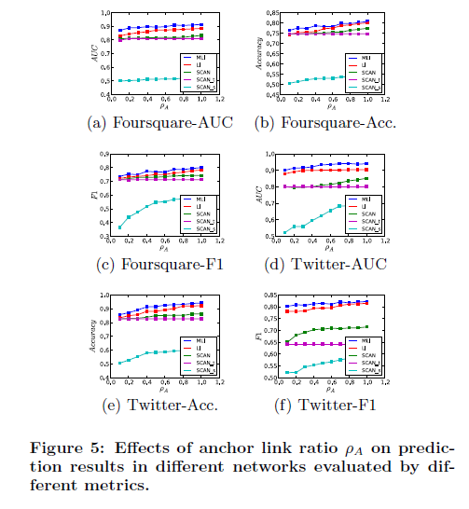
Datasets

Slide 19
Results

Slide 20
Results

Slide 21
Outline
Introduction
Framework
Experiment
Conclusion

Slide 22
Conclusion
We have studied the multi-network link prediction problems across partially aligned networks.
An effective general link prediction framework, MLI, has been proposed to solve the problem.
MLI can work very well in predicting social links in multiple partially aligned networks simultaneously.

Slide 23
Thanks For Listening

